Slide 1
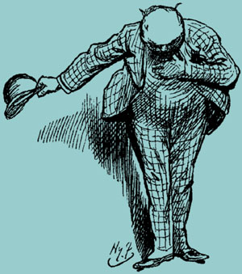
Los saludos / la cortesía

Slide 2
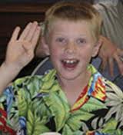

Slide 3


Slide 4


Slide 5


Slide 9


Slide 10

I am delighted to meet you.
I’m pleased to meet you.

Slide 11


Slide 12
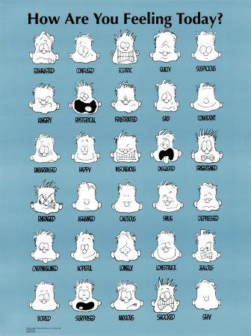

Slide 14


Slide 17



